Slide 1
Accountable Communities for Health (ACH)
A place where communities come together to make change happen.
Because no single entity can solve today’s complex health problems alone.

Slide 2
^{The Value Proposition}
Accountable Communities for Health (ACH) make transformational change possible, helping communities accomplish more than what could be done in health care, government or community settings alone:

Slide 3
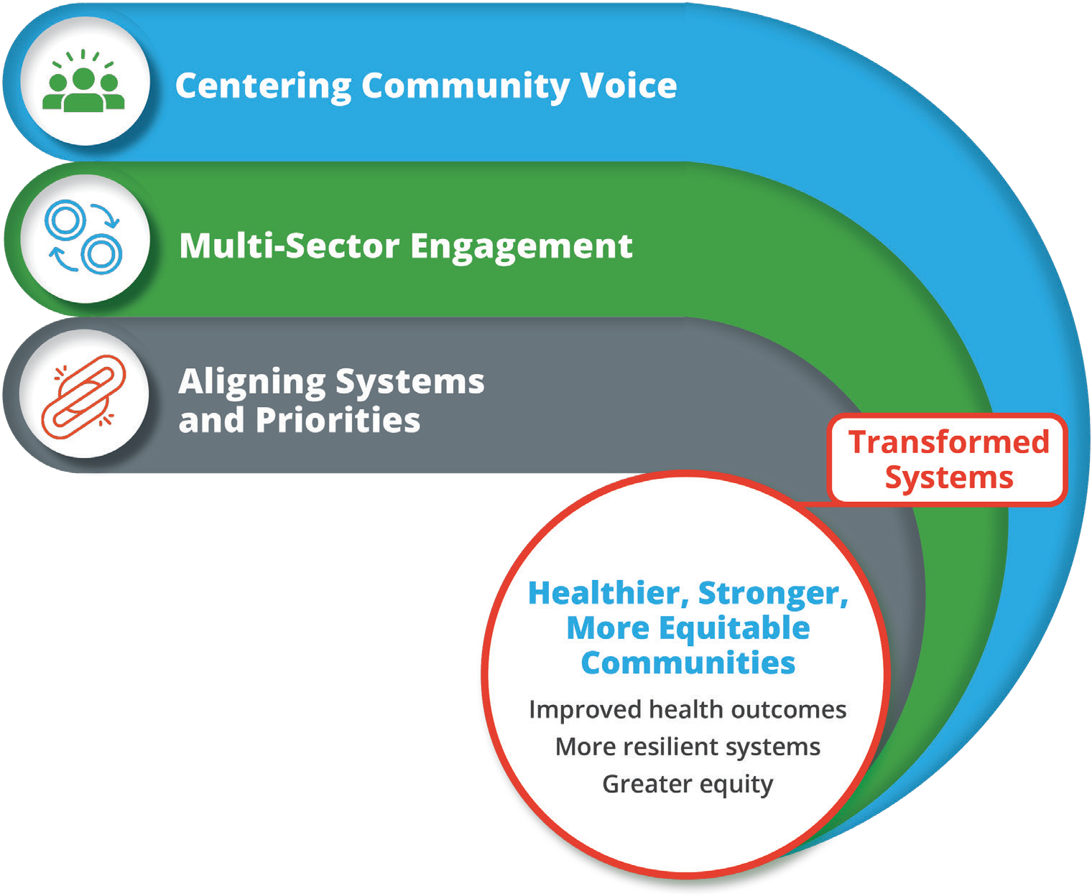
^{The ACH Framework}
1
CENTER
COMMUNITY VOICE
Community residents are too often excluded from critical decisions that impact their
health. ACHs reengineer this reality by placing residents at the heart of all community health- related discussions. ACHs level the playing field by ensuring that residents have a prominent and active role in their ACH,
helping to ensure that equity—and the realities that shape their health—is
paramount.
2
MULTI-SECTOR ENGAGEMENT
ACHs include not only traditional healthcare and public health systems, but
also, partnerships that embrace the social drivers of health because improving health outcomes for all
requires that health and other sectors, which reflect the various contributing factors needed for healthy communities, work in concert.
ALIGN SYSTEMS AND PRIORITIES
3
ACHs help partners shift from transactional, program-specific approaches to a new norm where participants align local community interests, incubate fresh ideas and expand collective capacity. Built on a foundation of transparency and data sharing, this alignment results in greater impact than any one entity could achieve alone. By ensuring both transparency and accountability, trust is built among ACH members and the community.

Slide 4
^{How to Launch & Grow}
Developing an ACH is an iterative process involving multiple stages and interdependent steps.
While one element may logically flow to the next, this process is fluid. ACHs are complex and can be influenced by countless factors, many of which will be out of leaders’ hands. The goal is to continuously grow stronger and more equitable, while evolving to adapt to the latest challenges and opportunities.

Slide 5
^{Key Functions of an ACH}
Elevating Community Voice
Inform, engage and activate community leaders and residents
Recruit resident participation
Ensure residents have a role in decision-making
Facilitating Action
Engage employers, sectors, systems and residents
Convene stakeholders for cross-sector collaboration
Provide technical assistance
Facilitate data sharing and analysis
Identify community assets
Building Sustainability for Impact
Design and manage ongoing governance and infrastructure
Ensure leadership is distributed
Maintain communications
Facilitate fundraising and develop sustainable financing
Monitor progress and conduct evaluations
Stewarding Systems Change
Catalyze innovative thinking
Oversee alignment of stakeholder-defined strategies
Identify gaps and new solutions
Adopt new collaborative practices
Manage power dynamics
Influencing Policy
Identify and elevate community issues
Advocate for local and state policy change
BACKBONES ENSURE SUSTAINABILITY
Critical to every ACH is the presence of a strong, skilled and experienced Backbone entity to manage the ACH, deftly working across organizations to shepherd systemic change and develop a shared, collaborative mindset. The Backbone provides the glue that keeps the ACH together—managing personalities, schedules, priorities and timelines.

Slide 6
^{How ACHs Advance Equity}
Conducting targeted outreach and engage residents from communities that historically experienced discrimination
Ensuring that the ACH decision-making body is diverse, inclusive and equitable
Investigating structural causes of inequities by facilitating difficult conversations and collaboratively collecting data from target communities
Ensuring funding is prioritized to serve historically under-resourced communities and groups
Conducting a power analysis, develop power-sharing practices and intentionally increase—and monitor—community trust and participation

Slide 7
^{The Topline Message}
WHY
For decades, long-standing inequities have exacerbated health issues in low-income communities and communities of color, resulting in persistent health disparities. Efforts are too often siloed and exclude those adversly impacted by deeper systemic issues. As a result, good-faith efforts are usually limited and not sustainable.

Slide 8
^{The Topline Message}
WHAT
Accountable Communities for Health (ACHs) provide a powerful framework for tackling inequities by breaking down barriers and promoting a new way for all community members and stakeholders to work collaboratively together. ACHs rely on three key principles to deliver transformational change and health equity:
Centering Community Voice: ACHs place residents at the heart of all community health- related discussions. ACHs level the playing field by ensuring that residents have a prominent and active role in their ACH, helping to ensure that equity—and the realities that shape their health—is paramount.
Multi-Sector Engagement: ACHs not only include traditional healthcare and public health systems but also partnerships that embrace the social drivers of health. Improving health outcomes for all requires that health and other relevant sectors works in concert.
Align Systems and Priorities: ACHs help partners shift from transactional, program-specific approaches to a new norm where participants align local community interests, incubate fresh ideas and expand collective capacity. Built on a foundation of transparency and data sharing, this alignment results in greater impact than any one entity could achieve alone.

Slide 9
^{The Topline Message}
ACTION
With your support and engagement, we can build a healthier, stronger and more equitable community. If you would like to see improved health outcomes for all and build more resilient systems, join us in supporting our Accountable Community for Health.

Slide 10
^{COMMUNITY VOICE}
Residents have a prominent and active role in ACHs, ensuring that operations and activities are representative of all parts of the community. This levels the playing field, mitigating power dynamics across sectors and organizations.

Slide 11
^{MULTI-SECTOR COLLABORATION}
Diverse interests—representing key sectors of the community—provide the insights, resources, access and capacity necessary to achieve meaningful change. The team’s mindset shifts from collaboration being “extra work” to “how we work,” allowing the group to marshal their collective power toward transformative action.

Slide 12
^{ACTIVE ALIGNMENT}
ACHs understand that multi-dimensional problems require multi-dimensional solutions. ACHs help partners shift from transactional, program-specific approaches to a new norm where participants align interests, incubate fresh ideas and expand collective capacity. Built on a foundation of transparency and data sharing, this alignment results in greater impact than any one entity could achieve alone.

Slide 13
^{ADAPTABLE}
ACHs recognize that they function in a dynamic world and therefore embrace flexibility, ensuring they can effectively and rapidly respond to emerging challenges and opportunities.

Slide 14
^{BACKBONE CONDUCTOR}
Critical to every ACH is a trusted backbone organization responsible for facilitating alignment between all ACH members and the community. More than administrative, these well-trained and connected conductors bring essential skills and resources to a collaborative enterprise.

Slide 15
^{EQUITY}
ACHs champion an equity-driven approach, incorporating multi-sector solutions focused on under-resourced populations. An equity lens is always core to ACH governance and decision-making, ensuring all community voices are at the table.

Slide 16
What have ACHs achieved so far?

Slide 17
ACH IN ACTION IMPROVED HEALTH OUTCOMES THROUGH:
^{Connecting Health}
^{& Social Services Providers}
By bringing together diverse partners, ACHs help link the health delivery system with social supports and other sectors, providing residents greater access to and coordination of the services and supports they need to thrive.

Slide 18
ACH IN ACTION IMPROVED HEALTH OUTCOMES THROUGH:
^{Connecting Health}
^{& Social Services Providers}
EXAMPLE: The San Diego ACH developed Neighborhood Networks, which facilitates linkages between health care systems and social services. It contracts with community-based organizations and community health workers to address patients’ health related social needs.

Slide 19
ACH IN ACTION IMPROVED HEALTH OUTCOMES THROUGH:
Alignment and Innovation
By emphasizing collective problem solving, ACHs incubate new ideas and align activities, leading to greater collaboration and impact.

Slide 20
ACH IN ACTION IMPROVED HEALTH OUTCOMES THROUGH:
Alignment and Innovation
Example: Humboldt Community Health Trust created recurring “huddles” among key stakeholders working on substance use disorder. The meetings provide key stakeholders with a space to improve cooperation, coordination and efficiency. At one huddle, partners agreed to improve transitions between providers by reducing repeat assessments.

Slide 21
ACH IN ACTION IMPROVED HEALTH OUTCOMES THROUGH:
^{Resilient Systems}
Because of the time and investment in relationship and trust building, systems are better prepared to weather complex and unexpected events, such as COVID-19 or a natural disaster, like wildfires.

Slide 22
ACH IN ACTION IMPROVED HEALTH OUTCOMES THROUGH:
^{Resilient Systems}
EXAMPLE: The East San José PEACE Partnership stepped up during the pandemic, facilitating Santa Clara County’s COVID-19 response, bringing an explicit equity lens to the distribution of essential resources—raising more than $600K for 700+ families who were not otherwise eligible for assistance.

Slide 23
ACH IN ACTION IMPROVED HEALTH OUTCOMES THROUGH:
^{Effective Local Policy}
ACHs leverage their collective power, influence and expertise to shape local policy, ensuring that city and county resources focus on the most effective public health interventions and advance equity.

Slide 24
ACH IN ACTION IMPROVED HEALTH OUTCOMES THROUGH:
^{Effective Local Policy}
EXAMPLE: East San José PEACE Partnership identified housing displacement as a root cause of community violence and developed strategies to safeguard residents teetering on the edge of eviction. After extensive community engagement, the plan was enacted into policy by the city, marking a first-of-its-kind blueprint for addressing this problem.
Notes:
Community Strategy to End Displacement – 10 point recommendations
Public/private team from San Jose was selected
Part of City-wide Residential anti-displacement strategies
Market-created phenomenon
Thoughtful about Policies and funding priorities to alleviate problem
10 strategies
Extensive community engagement and local research
Gap analysis
offers a wide range of policies and programs to both help tenants remain in their communities and foster the development of more affordable housing.
with thousands of San Jose residents teetering on the edge of displacement and evictions, city officials have laid out a 10-point strategy aimed at keeping as many low-income renters in the city as possible — marking a first-of-its-kind blueprint for addressing the pressing problem in San Jose.
“The East San Jose PEACE Partnership is a group of residents and organizations working to build a healthy, peaceful, and empowered community by preventing and addressing violence and trauma through comprehensive violence prevention efforts throughout three zip codes

Slide 25
ACH IN ACTION IMPROVED HEALTH OUTCOMES THROUGH:
^{Sustainable Funding}
ACHs are developing a variety of strategies to monetize their efforts and establish reliable funding streams that will sustain the ACH and fuel priority projects that promote community health and equity.
Notes:
Community Strategy to End Displacement – 10 point recommendations
Public/private team from San Jose was selected
Part of City-wide Residential anti-displacement strategies
Market-created phenomenon
Thoughtful about Policies and funding priorities to alleviate problem
10 strategies
Extensive community engagement and local research
Gap analysis
offers a wide range of policies and programs to both help tenants remain in their communities and foster the development of more affordable housing.
with thousands of San Jose residents teetering on the edge of displacement and evictions, city officials have laid out a 10-point strategy aimed at keeping as many low-income renters in the city as possible — marking a first-of-its-kind blueprint for addressing the pressing problem in San Jose.
“The East San Jose PEACE Partnership is a group of residents and organizations working to build a healthy, peaceful, and empowered community by preventing and addressing violence and trauma through comprehensive violence prevention efforts throughout three zip codes

Slide 26
ACH IN ACTION IMPROVED HEALTH OUTCOMES THROUGH:
Engaged Residents
Leveling the playing field and giving the community a driving role helps to build support, equity and cohesiveness. Through meaningful resident engagement, ACHs shift power.

Slide 27
ACH IN ACTION IMPROVED HEALTH OUTCOMES THROUGH:
Engaged Residents
EXAMPLE: The West Sacramento Accountable Community for Health organized a robust resident engagement strategy that involved hundreds of conversations with community members. Through this process, the collaborative identified three priority outcomes, one of which is community connectedness.

Slide 28
ACH IN ACTION IMPROVED HEALTH OUTCOMES THROUGH:
Engaged Residents
EXAMPLE: Reinvent South Stockton has deployed Trustbuilders throughout South Stockton neighborhoods for more than two years, engaging door-to-door with up to 100 residents each month, connecting them to health and other services, and increasing trust between public agencies and the communities they serve.

Slide 29
ACH IN ACTION IMPROVED HEALTH OUTCOMES THROUGH:
Enduring Platform
More and more, the ACH “table” takes on new issues because partners value the ACH as a trusted convenor and facilitator of new ways of working together for tackling complex issues.

Slide 30
ACH IN ACTION IMPROVED HEALTH OUTCOMES THROUGH:
Enduring Platform
EXAMPLE: Because of their multi-sector partnerships, several ACHs—Imperial, San Diego and Fresno—applied for and received grants from the state ACES Aware program in 2020.

Slide 31
^{What does this all add up to?}
^{Improved Health Outcomes}
By embracing a shared vision and learning to work together effectively, ACHs accomplish lasting, transformational change—and improved health outcomes.

